Slide 1

Data Analysis Project on the Mint Classics Company Database using CRISP-DM Methodology with SQL Workbench
Krantikumar Marathe

Slide 2

Agenda
Data plays a crucial role in decision-making within a company. With numerous datasets at hand, it’s essential to process data in such a way that it becomes valuable. In this project, I will attempt to put into practice how to conduct data analysis from a company’s database. The database used is a fictional one from a classic vehicle and car company known as Mint Classics Company. The project’s goal is to explore the data to provide insights and address issues within the company. I am using SQL Workbench software to facilitate data analysis from the database.
Overview:
Business Goal
Data Analysis
Findings
Recommendations
Conclusion

Slide 3
Business Goal Summary for Mint Classics Company
Objective:
Mint Classics Company aims to optimize its inventory management and warehouse utilization to enhance operational efficiency and cost-effectiveness. The primary focus is on evaluating the viability of closing one of their storage facilities while maintaining timely service to customers.
Key Goals:
1. Analyze Sales Patterns:
2. Inventory Optimization:
3. Warehouse Utilization:
4. Customer Service Impact:
5. Cost Reduction:
Final Outcome:
Provide data-driven recommendations to Mint Classics Company on whether to close a storage facility, how to reorganize or reduce inventory, and strategies to maintain or improve customer service levels while reducing operational costs.

Slide 4
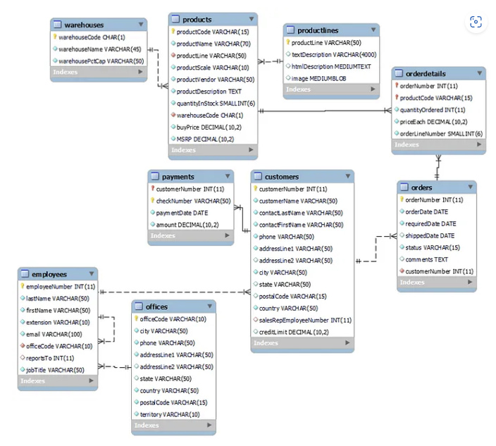
Warehouses compile data on the company’s warehouses used to store product inventory.
Products compile data about the product types, stock quantities, sales quantities, purchase prices, and more.
Product lines compile data about the descriptions of each product line they sell.
Customers compile data about the company’s customer profiles, such as customer names, addresses, credit limits, and others.
Payments compile data about payments made by customers, including payment dates and amounts.
Orders compile data regarding customer orders for specific products.
Order details compile data about orders for specific products, including the quantity of products ordered and the price of each product.
Employees compile data about company employees, including names, addresses, offices, and more.
Offices compile data about company office profiles.

Slide 5
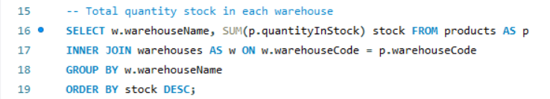
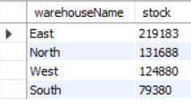
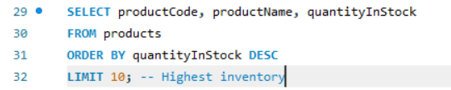
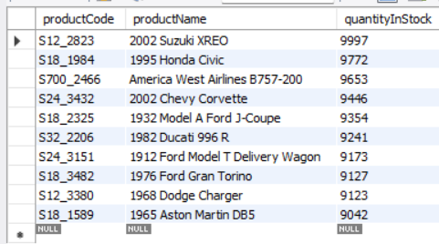
Inventory Analysis
1.
Output
2.
Output

Slide 6
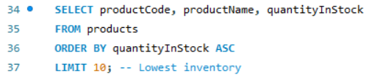
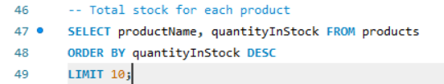
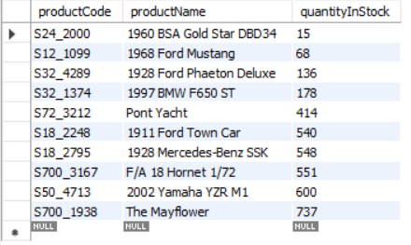
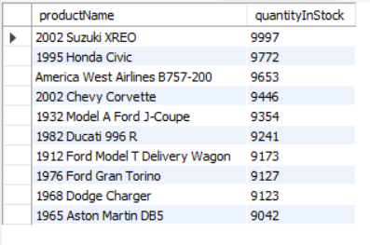
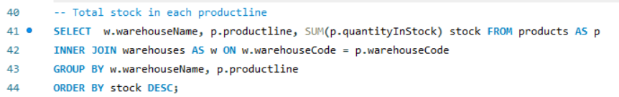
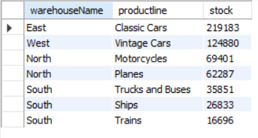
Inventory Analysis
1.
3.
Output
Output
2.
Output

Slide 7
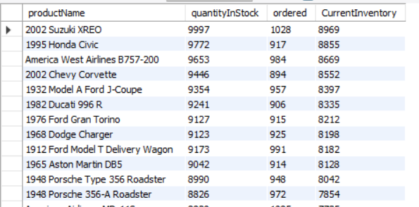
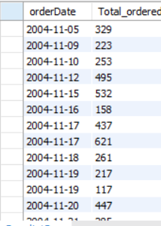
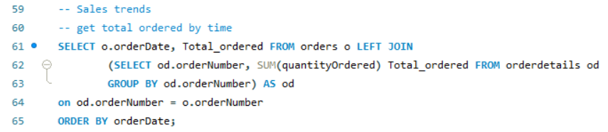
-Product sale Analysis
1.
Output
2.
Avg Order is 35.2190
Output

Slide 8
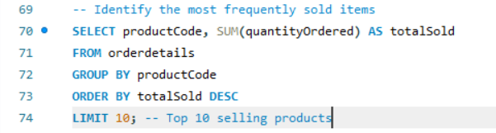
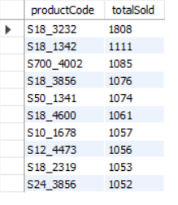
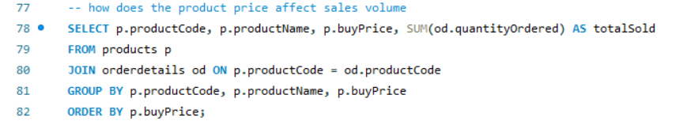
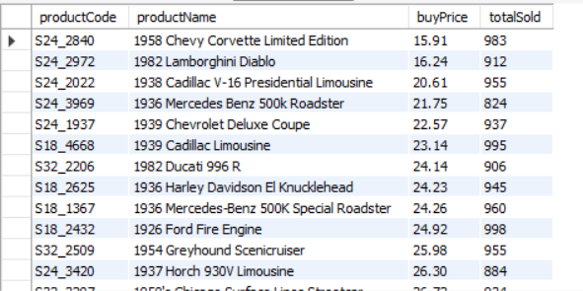
-Product sale Analysis
1.
Output
2.
Output

Slide 9
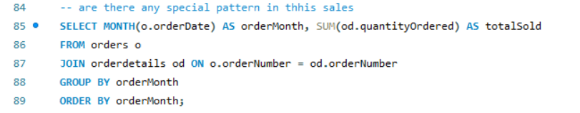
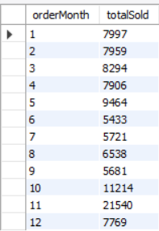
-Product sale Analysis
1.
Output
2.
Output

Slide 10
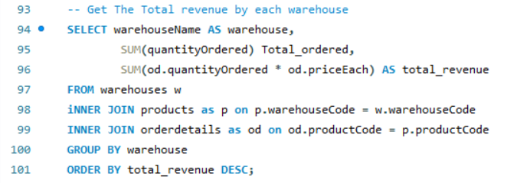
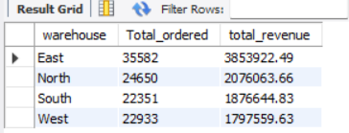
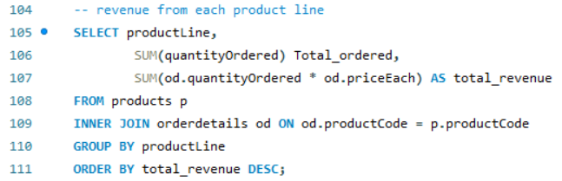
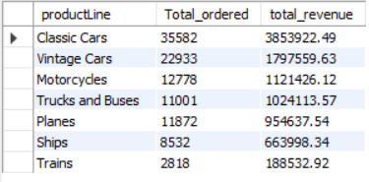
Company Revenue
1.
Output
Output
2.

Slide 11
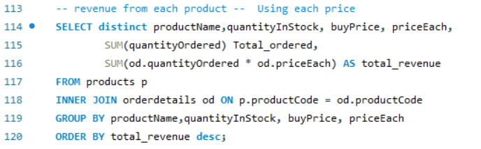
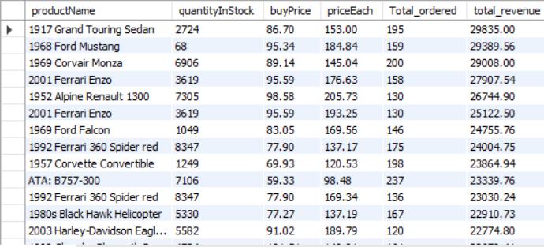
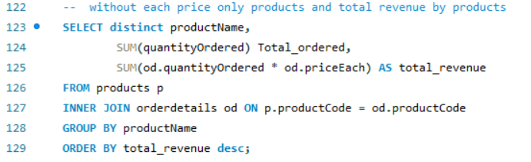
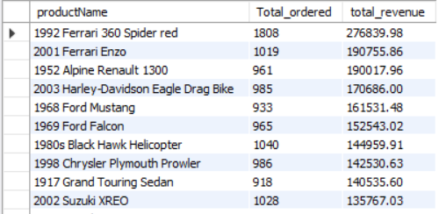
Company Revenue
1.
Output
Output
2.

Slide 12
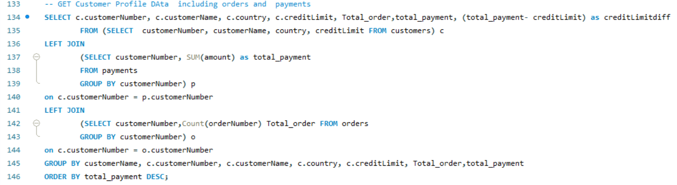
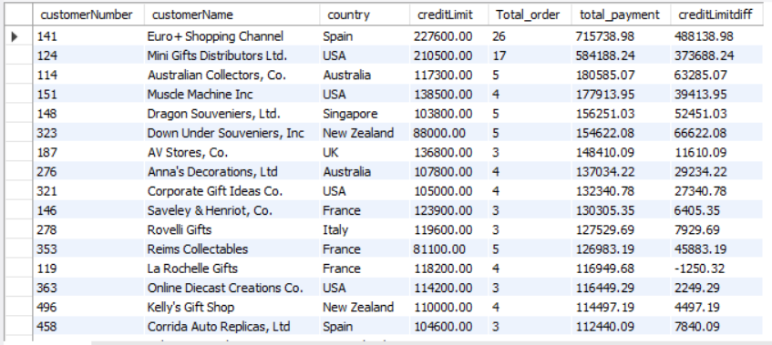
Customer Analysis
1.
Output

Slide 13
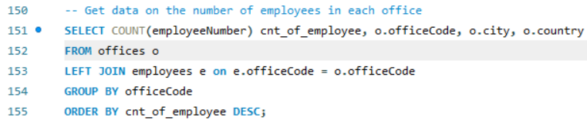
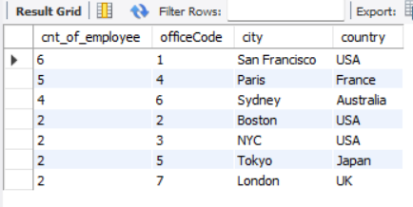
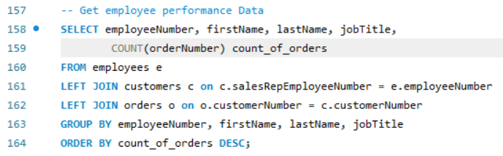
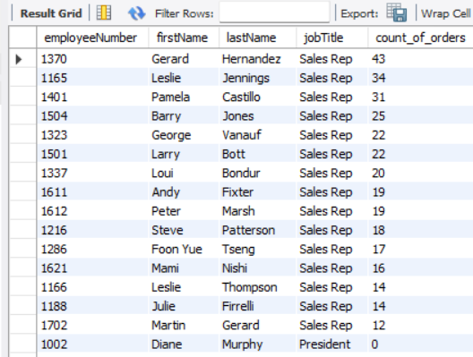
Customer Analysis
1.
Output
2.
Output

Slide 14
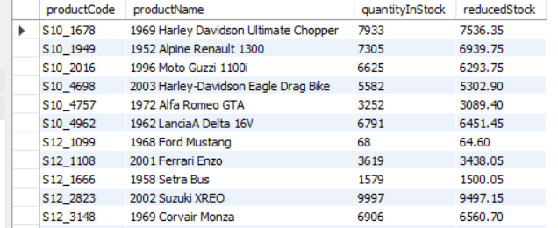
Conduct What-if Analysis
1.
Output
Output

Slide 15
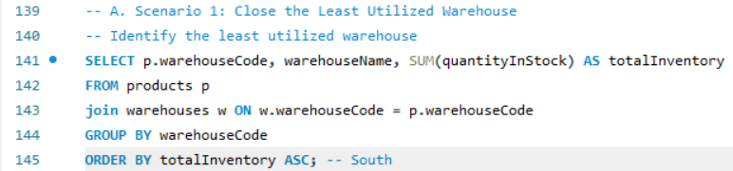
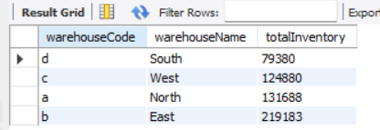

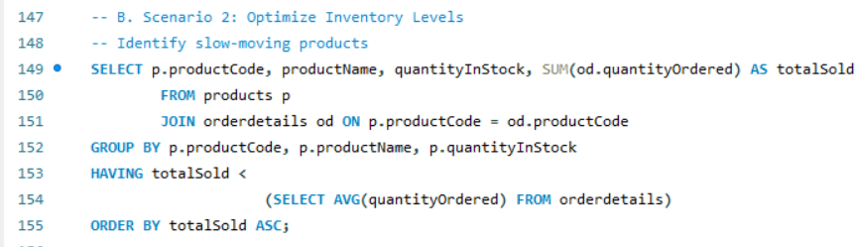

Formulate Suggestions and Recommendations
1.
Output
2.
Output
There is no Slow Moving Products all products Giving their best

Slide 16
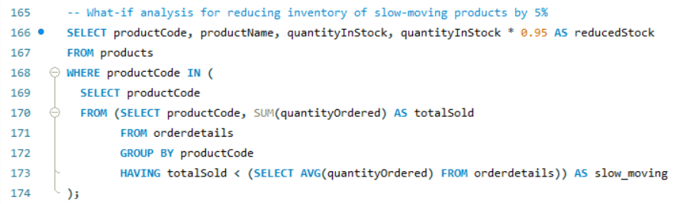
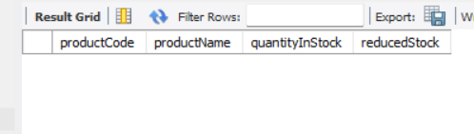
Formulate Suggestions and Recommendations
1.
Output

Slide 17
Evaluation and recommendation
Recommendations
Closing the Least Utilized Warehouse:
Redistribute inventory to other warehouses.
Analyze fulfillment and delivery times before and after closure.
Reducing Inventory of Slow-Moving Products:
Implement a 5% reduction in inventory levels for slow-moving products.
Present the potential reduction in storage needs.
In deployment step, the task is to present the findings. Therefore, I will attempt to recommend some policies that the company may consider, including:
Evaluating which products should be added and which should be reduced
Promoting in the countries with the highest order rates
Adjusting product prices so that the products can be sold
Implementing policies for customers with payment issues
Recognizing employees with good performance and providing training for those with lower performance
In evaluation step
There are warehouses with a significant product stock but generate relatively low revenue.
Some products have a high stock quantity but low sales or vice versa.
Certain product lines have substantial stock quantities but yield low revenue.
There are customers with good payments, but there are also customers with payment issues.
Some employees exhibit high sales performance, while others have lower sales performance.

Slide 18
Visualization

Slide 19
Visualization
S18_3232

